Slide 1
SPE VINYL DIVISION
SCHOLARSHIP AWARDEES 2024
Vinyltec 2024, Chicago

Slide 2
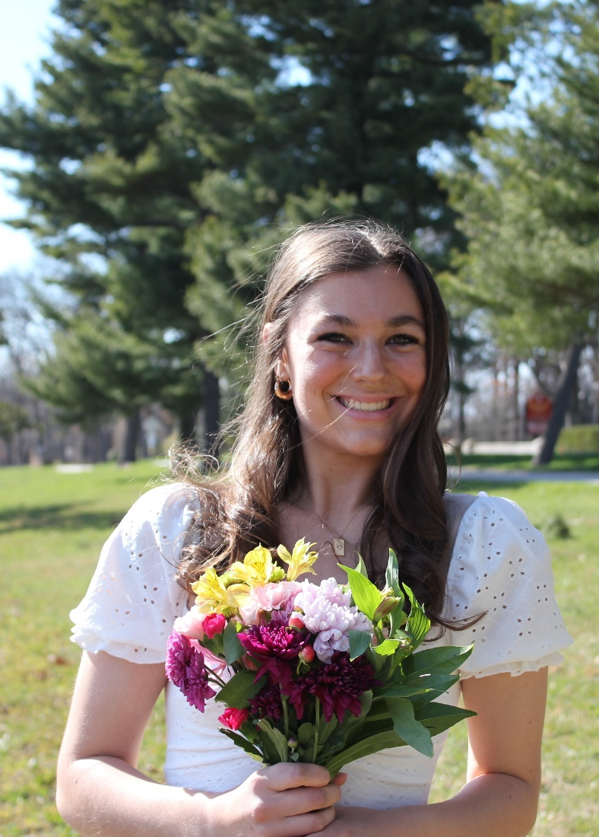
Katie lavallee
Katie is attending Purdue University in West Lafayette IN, majoring in Civil Engineering
Katie is the daughter of Paul and Peggy Lavallee

Slide 3
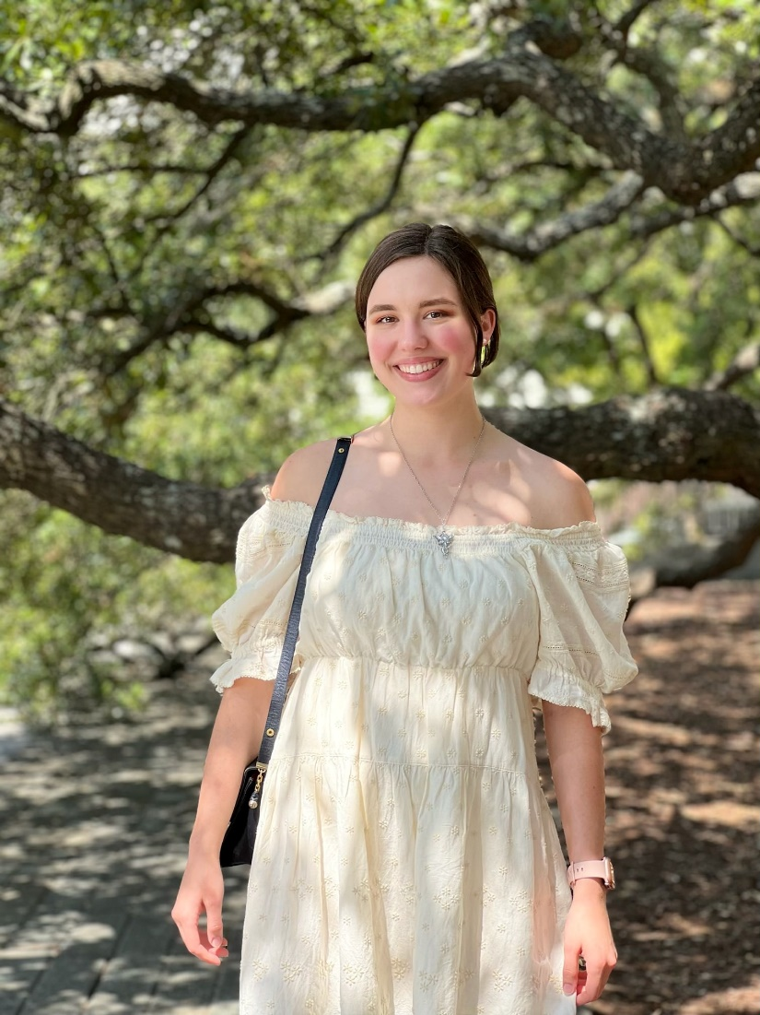
Isabella badeau
Isabella is majoring in Digital Art at Louisiana State University in Baton Rouge, LA
Isabella is the daughter of Curt and Jaime Badeau

Slide 4
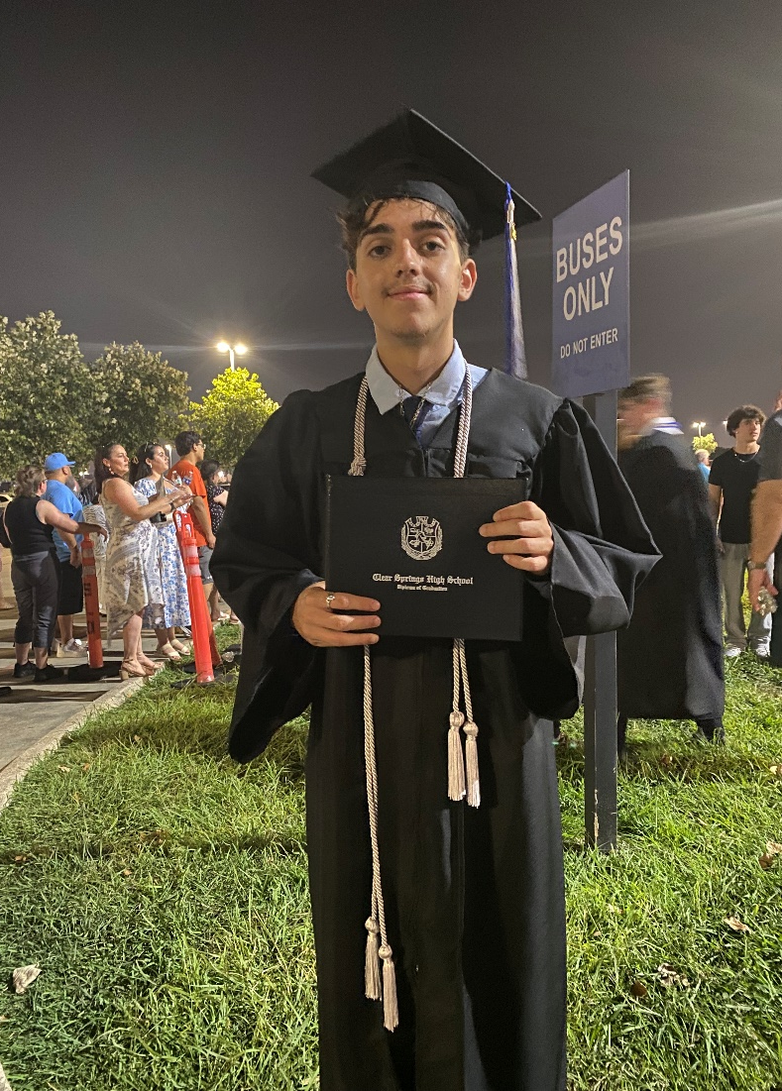
justin cascais
Justin is attending Texas State University in San Marcos TX, majoring in Business Administration
Justin is the son of Phil and Maria Cascais

Slide 5
Congratulations to our awardees and their families!
Grants are available to children of Vinyl Division members in good standing for a minimum of two years
This one-time grant is open to all students attending college, junior college or post HS Vo-Tech in autumn of the award year
See upcoming Vinyl Division newsletters for more details

